Slide 1
Where is Saint Lucia Located?
In relation to:
Neighbouring islands
Bodies of water
Lines of latitude
Lines of longitude

Slide 2
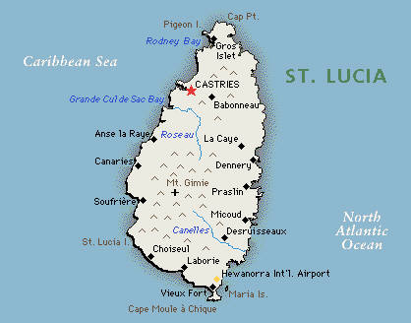
Saint Lucia is located in the eastern Caribbean Sea but also near the Atlantic Ocean.

Slide 3
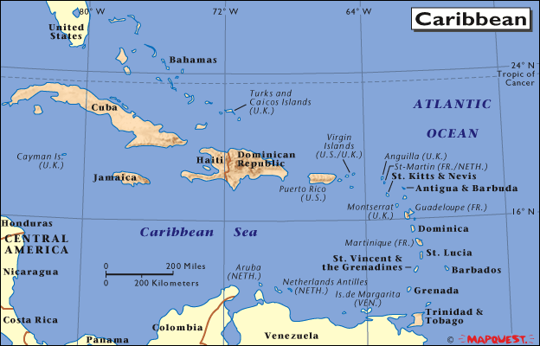

Slide 4
Saint Lucia is part of the Lesser Antilles and the Windward Islands. Saint Lucia is also located north east of Saint Vincent, north west of Barbados and south of Martinique.

Slide 5
Lines of Latitude and Longitude
What are they?
Let us view a short video to find out what these are.

Slide 6
Lines of Latitude
Latitude Lines are the lines running horizontally around the earth. They measure how far north or south a place is on the earth.

Slide 7
Lines of Longitude
Longitude Lines are the lines running vertically around the earth. They are also called meridians. These meridians measure how far east or went a place is.

